Slide 1


Optimizing Digital Experiences:
Test, Target, Personalize & Profit.
Sean Biek | Solutions Consultant
Marcus Cain | Account Executive, Marketing Cloud
Melissa San Soucie | Account Executive, Target

Slide 2

Target Overview
Targeting capabilities: what you get with AEM vs. Target
Discussion on Targeting within AEM UI vs. Target UI
Target Demonstration
Deployment & Dynamic Tag Management across Solutions (Target, AEM, Analytics, Aud Mgr)
Q & A

Slide 3
Targeting capabilities within AEM vs. Adobe Target
AEM targeting OOTB (without Adobe Target):
Rules based offers/experiences based on AEM defined segments
AEM + Target (using embedded Adobe Target):
A/B testing (available 12/15)
Geo-targeting
Experience Targeting
App Experience Targeting
Adobe Target:
A/B testing
MVT testing
Geo-targeting
Experience Targeting
Multi-page Journey testing & personalization
Analytics-enhanced reporting
Automated Personalization
Targeted Recommendations
Mobile App Optimization
App Experience Targeting
Contextual email personalization
Internet-connected Screen Optimization

Slide 4
Adobe Target Key Capabilities
A/B/N Testing
Testing one design, content or experience against another or several others for improving performance
Multivariate Testing
Testing multiple elements in creative or design to discover element contribution and optimal combination of elements
Geo-Targeting
Location-based targeting based on Reverse IP lookup and geo-fencing/iBeacon In mobile
Experience Targeting
Targeting content to an audience segment
Automated Personalization
Machine-learning algorithms for personalizing content & design to individual and audience segment discovery
Optimized Recommendations
Custom, optimized algorithms for offering next best content or product suggestions based on industry and touch point
Notes:
The Adobe Target solution provides a breadth of capabilities to promote an iterative testing and optimization process, where everyday assumptions are weighed based on their impact on the conversion goals and success metrics that mean the most for your business e.g. point of sale, account/rewards signup, engagement/time on site, customer lifetime value etc. Manual A/B/N and Multivariate testing with experience and geo-targeting are combined with automated machine-learning algorithms to enable an agile adaptive content strategy leading to effective levels of personalization for different audience segments of customers and even to the individual.

Slide 5
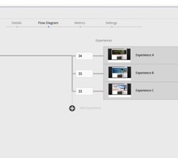
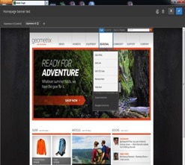
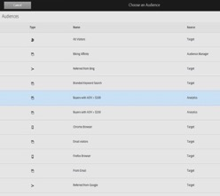
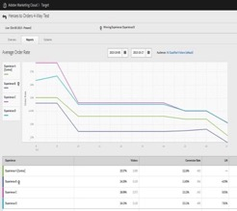

Adobe Target
Guided Workflow
Visual Experience Composer
Shared Custom Audience Library
Server-side Analytics Integration
Adobe Marketing Cloud Integration
Step-by-step framework for building quick effective tests or targeted activities
Best practices built into prompts within set-up process
Easy to pick-up & learn, review older activities or share, QA and socialize new activities
Onsite WYSIWYG editor which allows non-technical marketers ease in making basic text, image or design variations as well as more advanced content edits, including Move, Rearrange, Resize & Insert
Central library for out-of-the-box, custom built, or Marketing Cloud-sourced audience segments to be selected, edited or reused
Automatic segment sharing from Analytics & AudienceManager
Filter Target reports by any Analytics metric or segment
Target reports available in Analytics with same data
New Segments built in Analytics can be leveraged in Target Activities
Post reports up to the Cloud for context and collaboration across Digital Marketing organization
Share “report cards” that auto-update performance in real-time

Slide 6


















Adobe Marketing Cloud
SOLUTIONS
MEDIA OPTIMIZER
CAMPAIGN
SOCIAL
EXPERIENCE MANAGER
TARGET
ANALYTICS
PRIMETIME
AUDIENCE MANAGER
CORE SERVICES
PROFILES & AUDIENCES
ASSETS
ACTIVATION
MOBILE
EXCHANGE
COLLABORATION
ADMINISTRATION
PLATFORM
Data & Content
Notes:
Let’s start off with a quick look at the big picture. Everything we talk about at Summit is part of the big picture story of Adobe Marketing Cloud. Well, here is a quick look at Adobe Marketing Cloud, in all its glory.
I don’t want to spend a lot of time here, but we want to be clear that Adobe Marketing Cloud is not just a slogan, a campaign, or a gimmick. Analysts have universally agreed that when it comes to marketing clouds, or hubs, or suites, or whatever you care to call them, Adobe has the secret sauce that actually makes the sum greater than the value of the individual parts.
UNLIKE other marketing suites and bundles that are an incomplete collection of point products that are barely interoperable, much less integrated, Adobe Marketing Cloud is a comprehensive set of best-in-class, integrated solutions, all built on a common data platform with a common set of powerful core services that creates a lift and, dare we say it, synergy you can’t get with a jumbled toolbox.
Adobe Marketing Cloud consists of 8 comprehensive and integrated solutions. This is where the execution happens:
Adobe Analytics—Get real-time analytics across online and offline channels to continuously improve the performance of marketing activities.
Adobe Experience Manager—Organize, manage, and deliver creative assets and other content across digital marketing channels.
Adobe Campaign—Plan and execute orchestrated campaigns across all channels.
Adobe Target—Test and target digital experiences to maximize business results.
Adobe Media Optimizer—Manage, forecast, and optimize your media mix to deliver peak return on your spend.
Adobe Social—Manage social marketing with a comprehensive platform that enables social listening, publishing, and analytics.
Adobe Primetime--Engage viewers across devices and deliver targeted ads independent of platform or device.
Audience Manager – Identity Management. Audience Activation, Cross Device Measurement, Audience Marketplace , Audience Optimization
And above and beyond best in class individual solutions, once you own any part of Adobe Marketing Cloud, you get the secret integrated sauce.
Adobe Marketing Cloud Core Services—A set of core technologies that allow each of the solutions to tap into a common framework and architecture, including Profiles & Audiences, Assets, Activation, Mobile, Exchange, Collaboration, the Exchange partner network, and User Management and Administration, all built upon a common data platform.
=======================
KRUX are mostly a sell-side DMP that works with publishers. Similar to Lotame. The buy-side players are x+1 & Turn, who work mainly with advertisers. AAM has extensive experience servicing both sides of the equation. This gives us an advantage in that it allows our clients (publishers and advertisers) to leverage the AAM footprint to strike up powerful 2nd party data sharing programs. This is what the data marketplace initiative is all about (and will be pushed hard at EMEA Summit).
They have a big initiative around cross-device targeting and make some big claims. I’m not so sure about how great they are on that front. We’re a little behind on the messaging around this, but we are building the back-end to support this in a major way. They wouldn’t be able to scale it in the way that we plan to (using our customer’s 1st party data to stitch everything together).

Slide 7

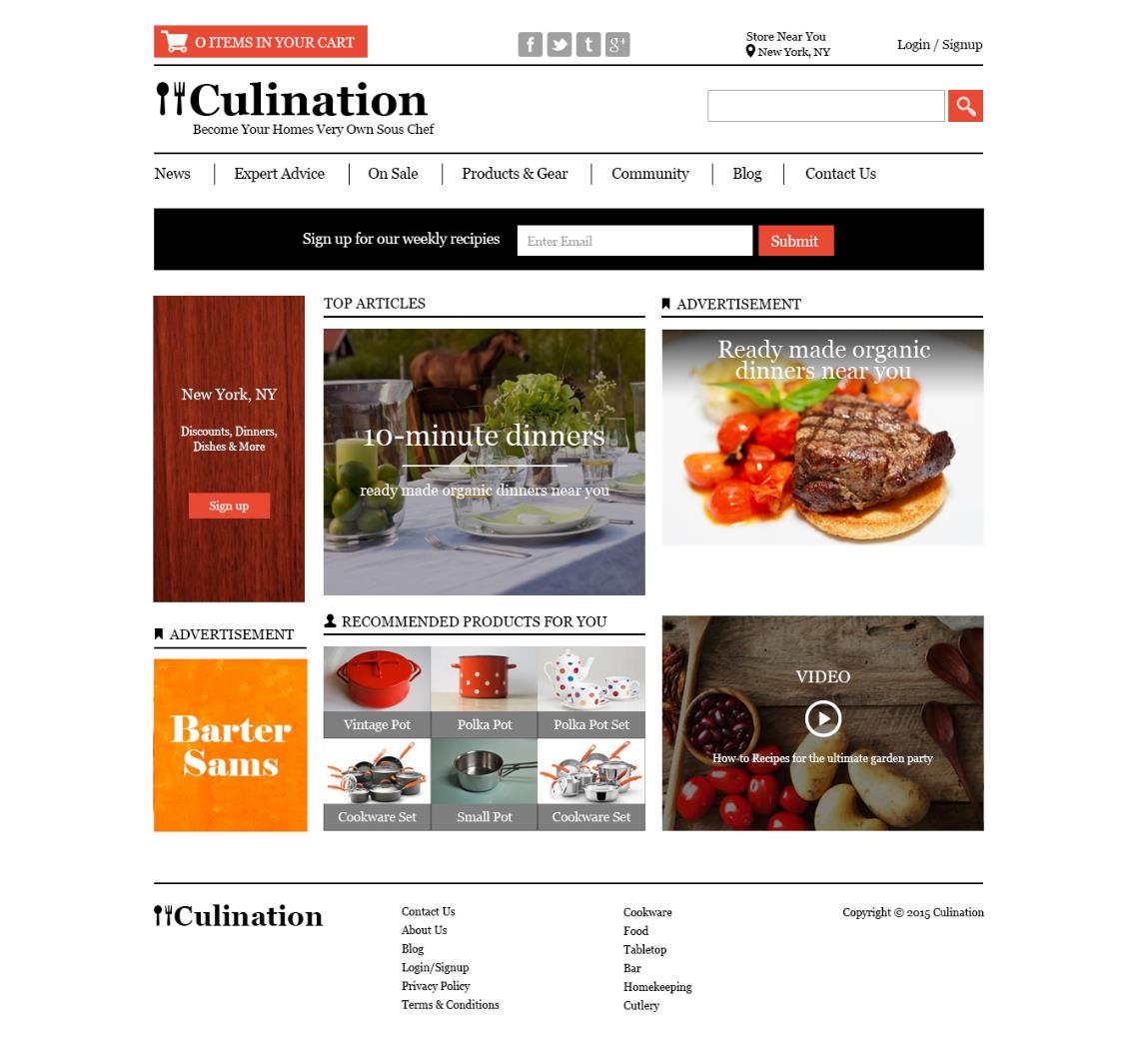
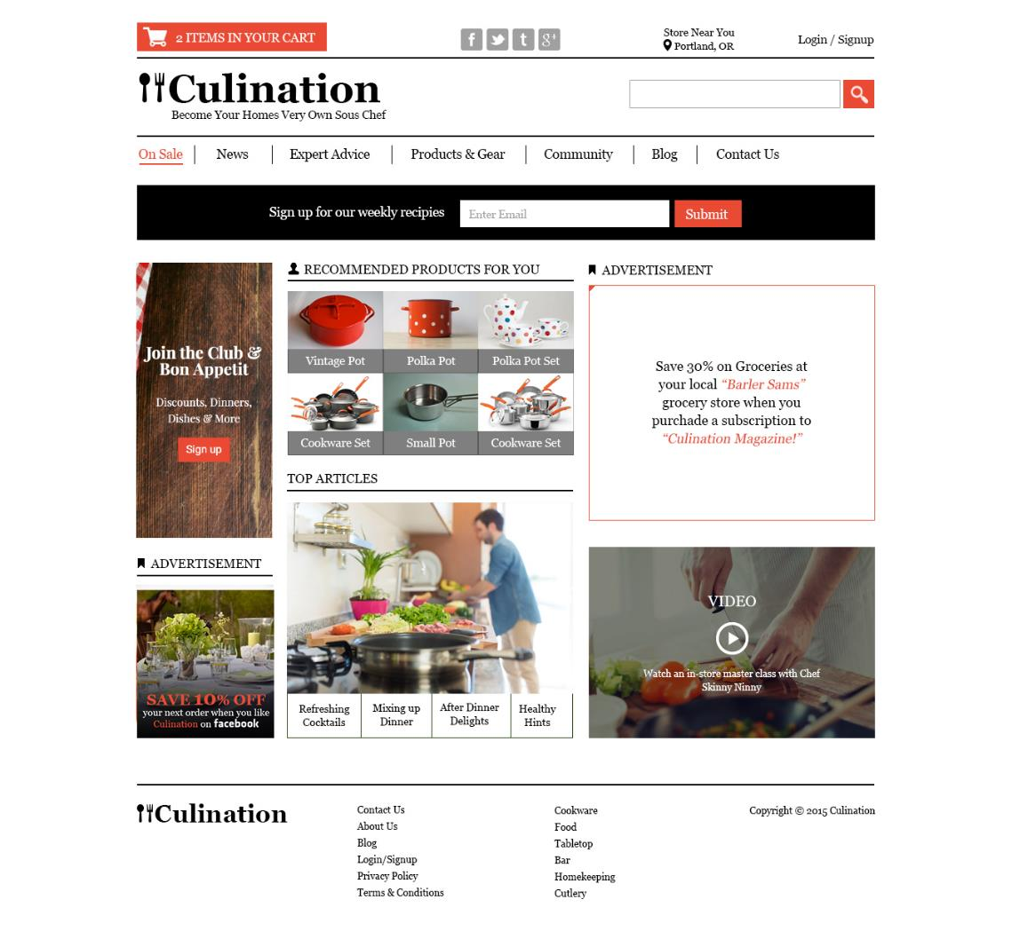
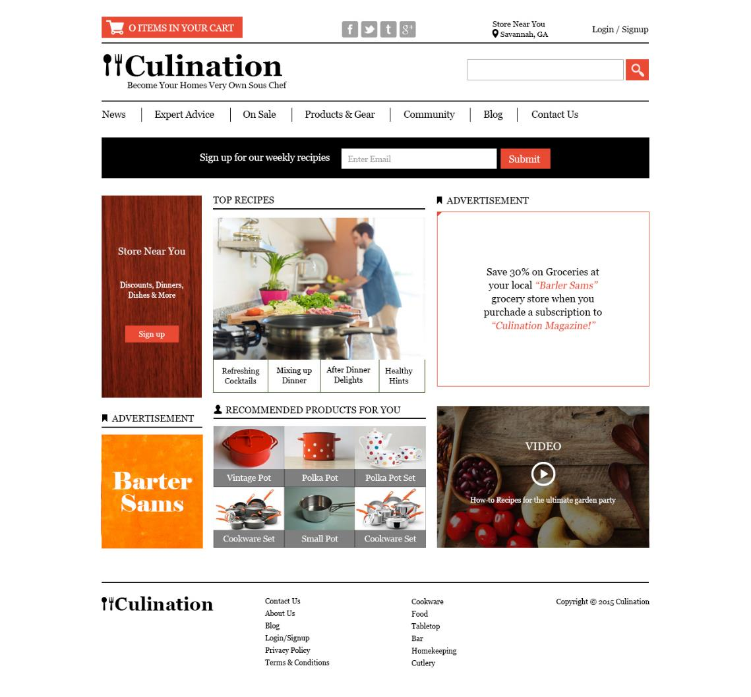
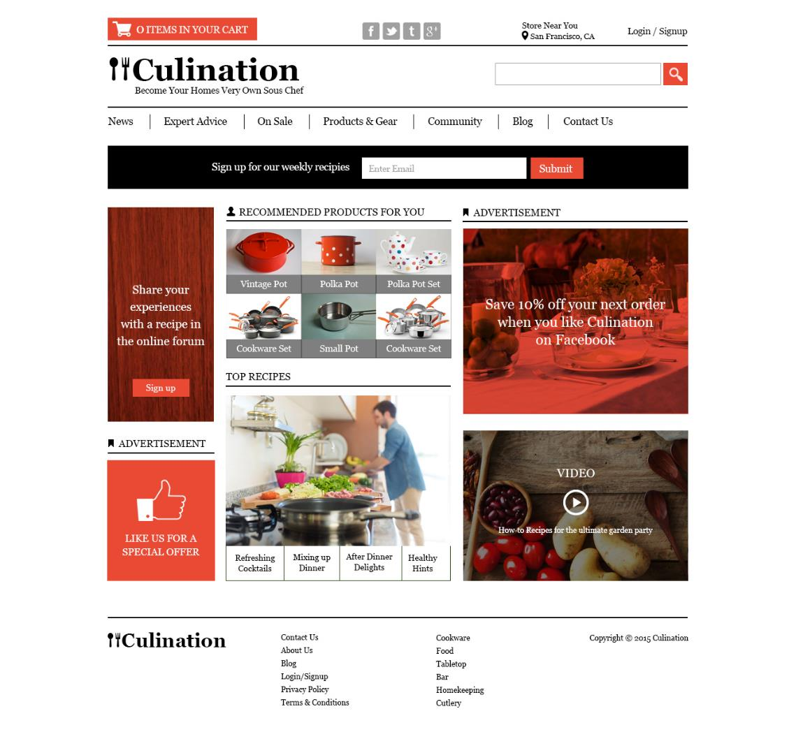




Utilitarian Working Father
Recipe Hunter
Sales-Driven Consumer
Social Media Blogger
Notes:
Ultimately what we’re aiming to achieve is the best design and layout for each of these digital properties based on the device and the needs of our customers. For example, does content provide value or service here? What is the right content to deliver? Is it the best look/feel and function to meet customer expectations? Can we improve the imagery, the messaging, the navigation or the call to action to improve performance?
We’re also looking to define the best adaptive content strategy for each location on the page. Should I be targeting content here? What are the best rules for defining which variation of content or offer a visitor sees? Do I have previous insights on which profile variables might be most predictive for targeting based on analytics or test results, or can automation assist with the discovery process?
Each of these areas of design and content decision-making can and should be explored with testing optimization, to feel confident that you’re making the best decision for a diverse customer base, and that they are able to see an adapted experience that satisfies their preferences, expectations and needs.

Slide 8

Why optimize?
1. Because you want to deliver personalized experiences
2. Because you want to create a more efficient path-to-conversion point
3. Because you need automation AND marketer control to ensure digital campaign success
4. Because launching a new website or mobile app is a risky proposition

Slide 9







Based on what we know: unified progressive visitor profile
Gender: Female
Favorite Blog: 101 Recipes
Age: 30-40 years old
Recent Purchases:
Stand Mixer
Dessert Cookbook
Augmented with 2nd & 3rd Party
Data via Customer Attributes Core Service, API or Analytics
Interest(s): Making Desserts
City: Washington DC
First Party Data
+
Environment
Variables
Site Behavior
Variables
Referrer Variables
Temporal Variables
Analytics
Offline
Variables
IP address
Country of origin
Time zone
Device type
Operating system
Browser type
Connection Speed
Screen resolution
Customer / Prospect
New/return visitor
Previous visit patterns
Previous Product interests – top level
Previous Product interests – low level
Searches
Previous online purchases
Previous Campaign exposure
Previous Campaign responses
Referring domain
Campaign ID
Affiliate
PPC
Natural search
Direct/bookmark
Social graph/login
Time of day
Day of week
Recency
Frequency
CRM
Call center
Ticket sales
Partner data
3rd-party data
Notes:
Our progressive visitor profile begins at first touch, and continues to grow and is available at each subsequent touchpoint as a customer continues to engage with your content. We automatically collect a wide array of first party data, including geo-location down to the zip code, environment variables, site behavior variables, referrer variables and temporal variables listed here. This profile is assigned a universal Marketing Cloud ID that allows ease of augmenting first party data with any 2nd (e.g. CRM, call center, partner data) or 3rd party data (e.g. purchased data feeds, credit score etc) to create a rich , well-rounded view of the customer that allows for greater clarity in test results and the personalization of content to this individual.

Slide 10

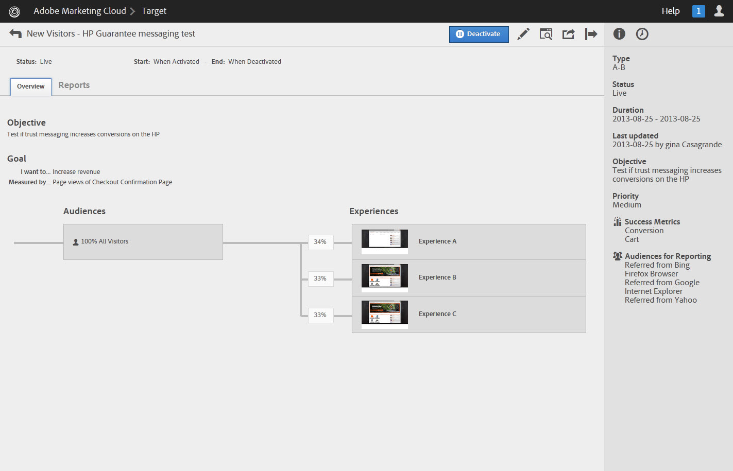
ADOBE TARGET: the Personalization Engine of Adobe Marketing Cloud
Capabilities
Paves a path from basic testing to targeting to true segmentation and personalization through:
A/B…N and Multivariate Testing
Geo & Experience Targeting
Automated Personalization
Targeted Recommendations
Email & Offsite Marketing Optimization
Mobile Web & App Optimization
Open Set of APIs
Internet-Connected Screen Optimization
Marketing Cloud Core Services Access
Notes:
Adobe Target
Adobe Target is where the market is realizing MM’s even 10 of MM’s of dollars of value by relentlessly testing, targeting, recommending and delivering on the promise of personalization. It is rooted in data, smart math and content workflow (Data from analytics, Content from AEM and is armed with killer math). It is the difference between a hit and a swing and a miss in delivering the last millisecond.
Test & Target, Search&Promote, Recommendations, behavioral target – all part of an optimization program. Now you have a single solution to deliver on this. Adobe Target. All capabilities, one price.

Slide 11
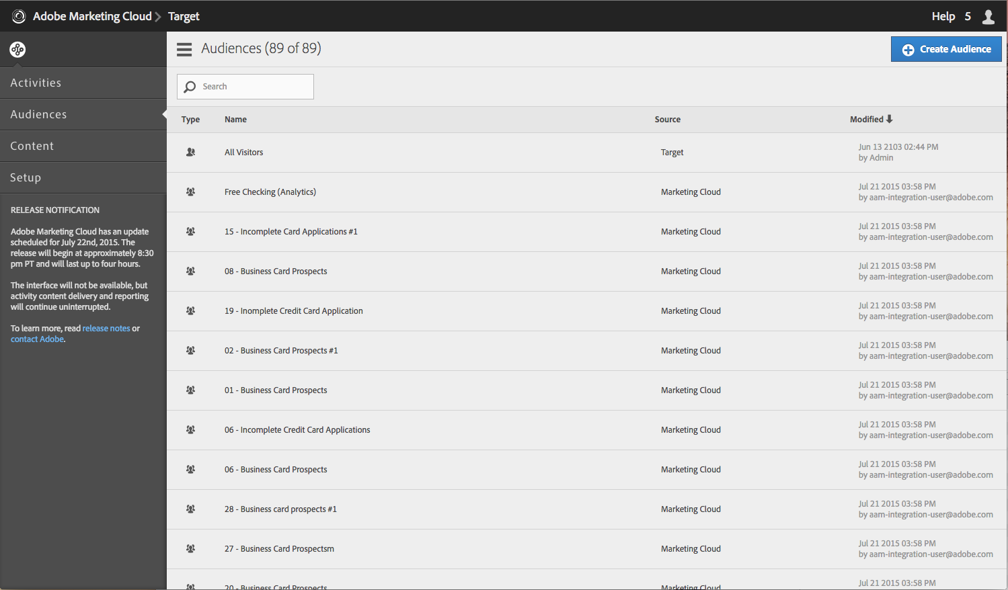

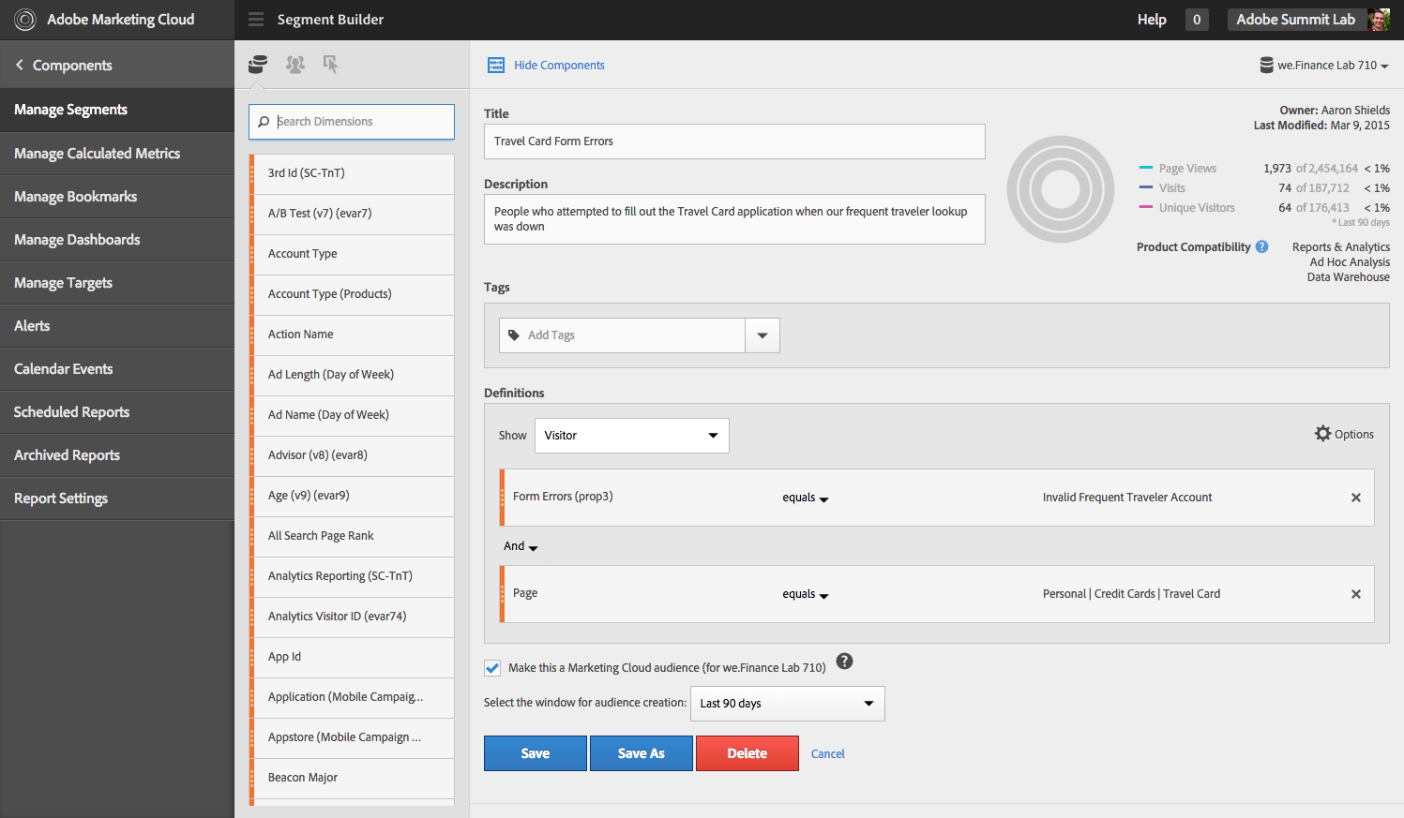
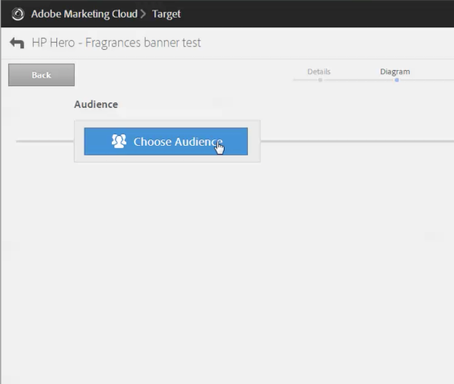

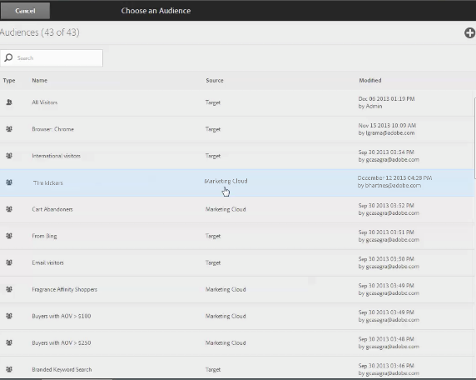
Identifying high value audience segments that can be actionable in Adobe Target
Adobe Marketing Cloud
Target
11
Notes:
What we are looking to define is the most predictive variables of the profile for identifying the right content to target at a given point. As we discover and analyze predictive audience segments in other Marketing Cloud solutions such as Analytics or AudienceManager, these same audience segments can be shared directly to Adobe Target to begin to take action on them, by including them in a test, algorithm or targeting activity. This is a unique value proposition for Analytics and Adobe Target in the Marketing Cloud. The audience segment definition is the same, due to the unified Marketing Cloud profile. There is no variance between the data in Analytics and Adobe Target, which makes Analytics audience segments actionable in Adobe Target, and enables full access to deep Analytics analysis (any audience segment or success metric, even retroactively applied) natively within Adobe Target reports for full clarity of results and strategy moving forward after a test is complete.

Slide 12




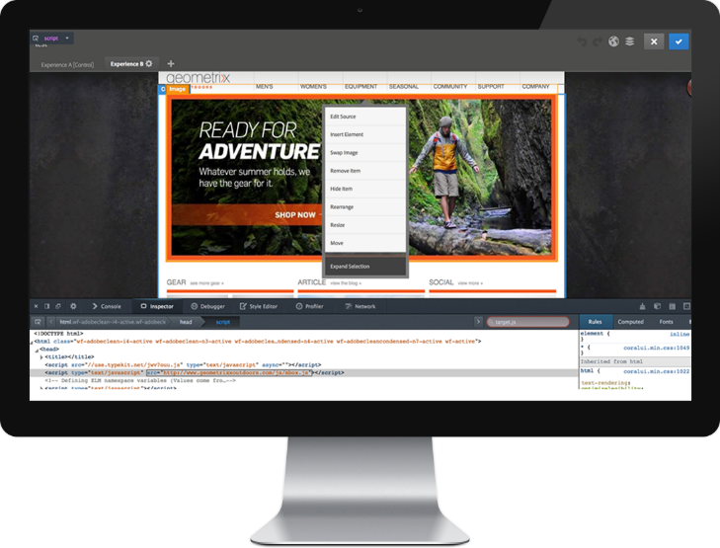




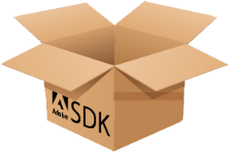
Ease of implementation for executing iterative testing and personalization everywhere
Digital
Publishing
Suite
PhoneGap
Enterprise
One SDK
Analytics
Audience Manager
Target
Single line of code for web
& mobile sites
APIs for Email, Display &
Internet-Enabled Screens & consoles
Flexible Mobile App SDK

Slide 13
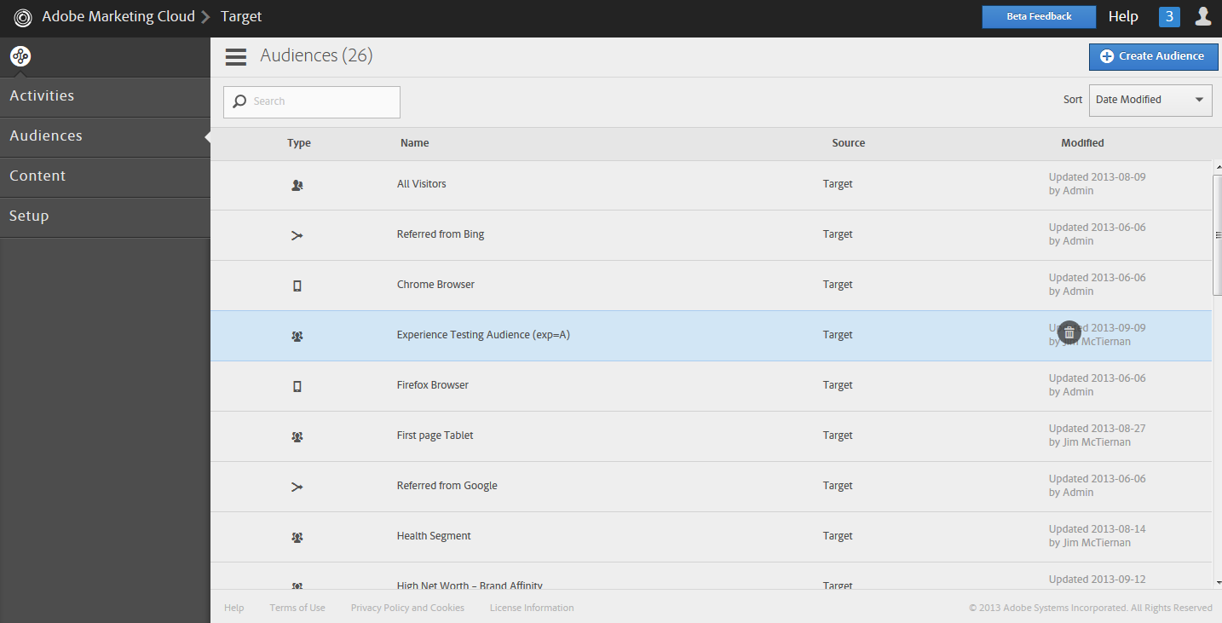
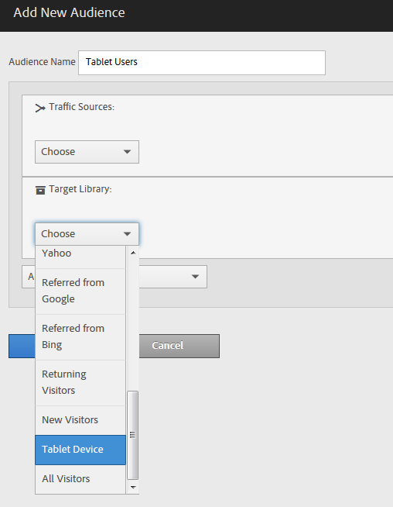
The Universal Target Profile
Easily define a new Audience segment based on Profile
Notes:
Hundreds of Variables Make up the Personalized Visitor Profile
Note that data collected is anonymized to protect user privacy
Profiles are constantly updating and evolving to provide an current view on what the visitor’s interests and objectives are.

Slide 14
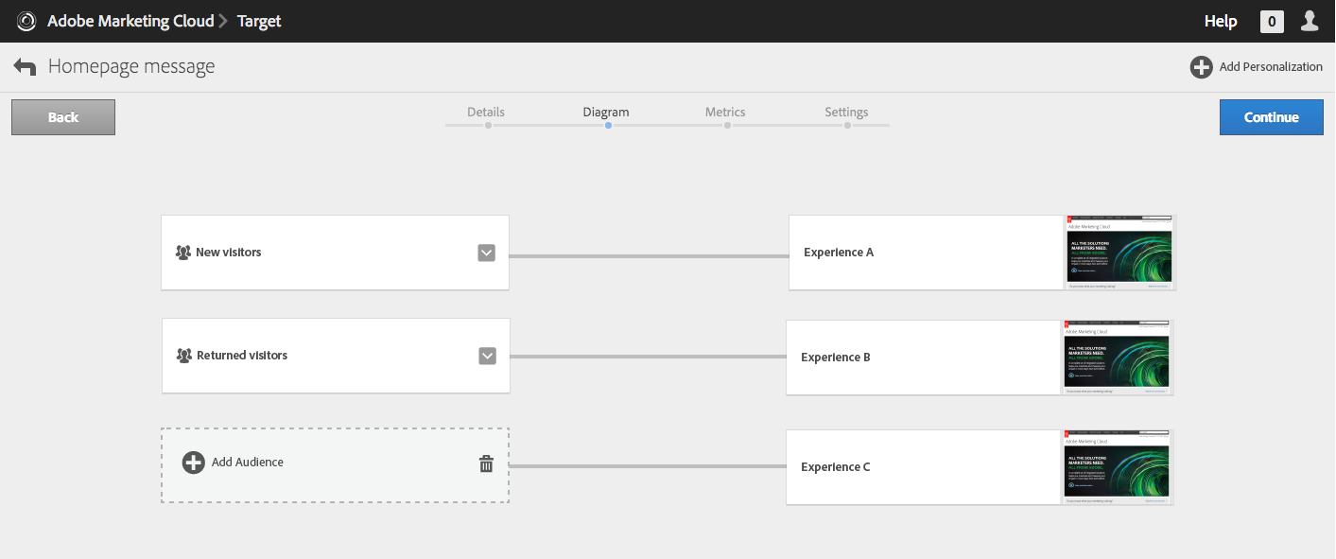
Create Rules-based Targeting Activity for New Segments
Easily build multiple Experiences for different Audiences in one Activity
Notes:
Hundreds of Variables Make up the Personalized Visitor Profile
Note that data collected is anonymized to protect user privacy
Profiles are constantly updating and evolving to provide an current view on what the visitor’s interests and objectives are.

Slide 15
Automated Personalization Capabilities

Slide 16
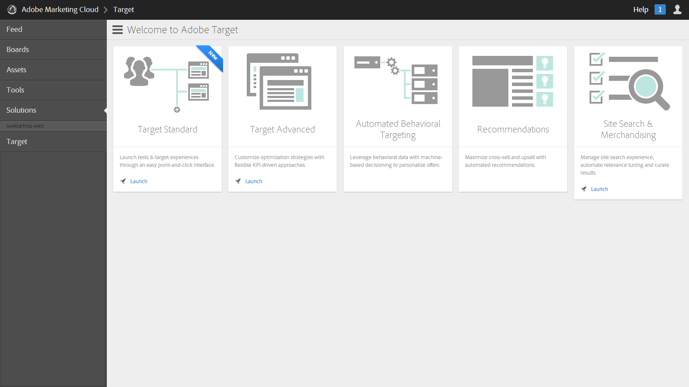
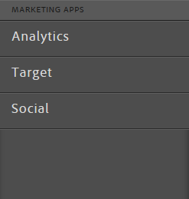
Adobe Target – Single Solution for Optimization and Personalization Strategies
Automated Personalization
Self Learning Targeting Algorithm
Automated Audience Segment Discovery
Machine Based Personalization

Slide 17











What feeds the automated personalization model?
site behavior
variables
offline variables
CRM
Call center
Ticket sales
3rd-party data
Customer / Prospect
New/return visitor
Previous visit patterns
Previous Product interests – top level
Previous Product interests – low level
Searches
Previous online purchases
Previous Campaign exposure
Previous Campaign responses
environment
variables
referrer variables
IP address
Country of origin
Time zone
Device type
Operating system
Browser type
Screen resolution
Referring domain
Campaign ID
Affiliate
PPC
Natural search
Direct/bookmark
Social graph/login
temporal variables
Time of day
Day of week
Recency
Frequency
Notes:
Creating a “digital” finger print is an important key to creating a personalized experience for your customers. High-dimensional data, combination exponential.

Slide 18






How Does Automated Personalization Work?

Slide 19








Offer Scoring per Visitor Reflects Probability They Will Convert on an Experience
5.54%
10%
1.4%
1.08%
0.1%
0.75%
General
Personalized
Combined Score
Personalized
General

Slide 20
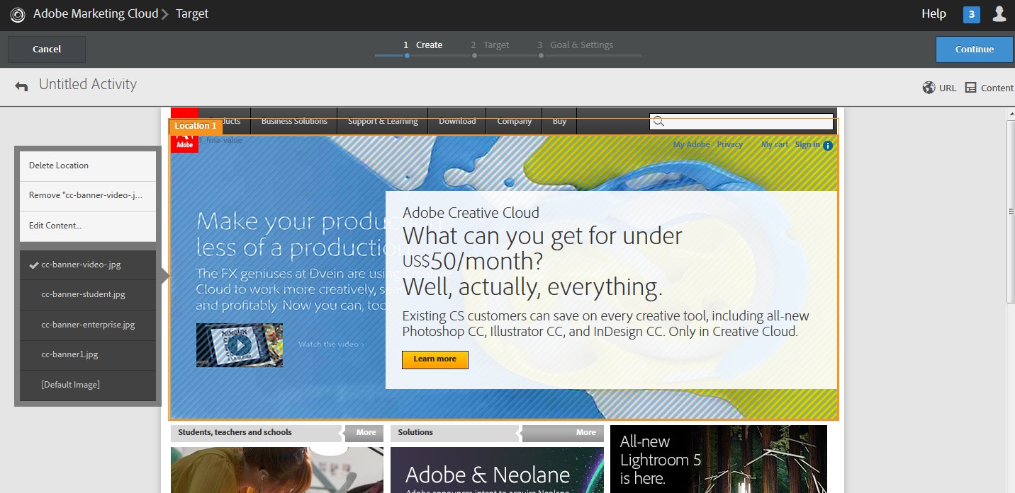
Easy Set-up of Automated Personalization Activities
3-step workflow to set-up Automated Personalization activities

Slide 21
Real Time Reporting & Analytics

Slide 22
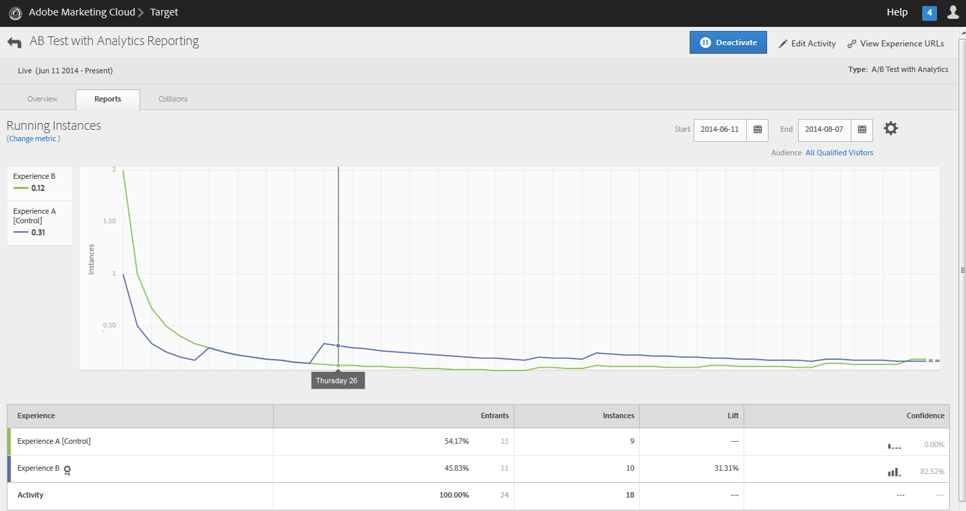
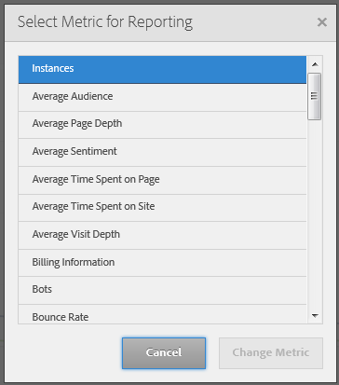
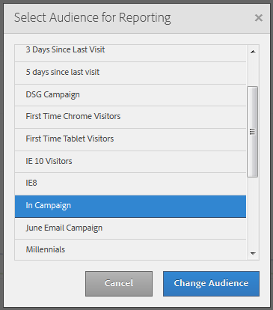
Real-time Reporting Based on Any Adobe Analytics Metric or Segment
Break down any Target Activity by any Analytics Audience, using any Analytics Metric

Slide 23
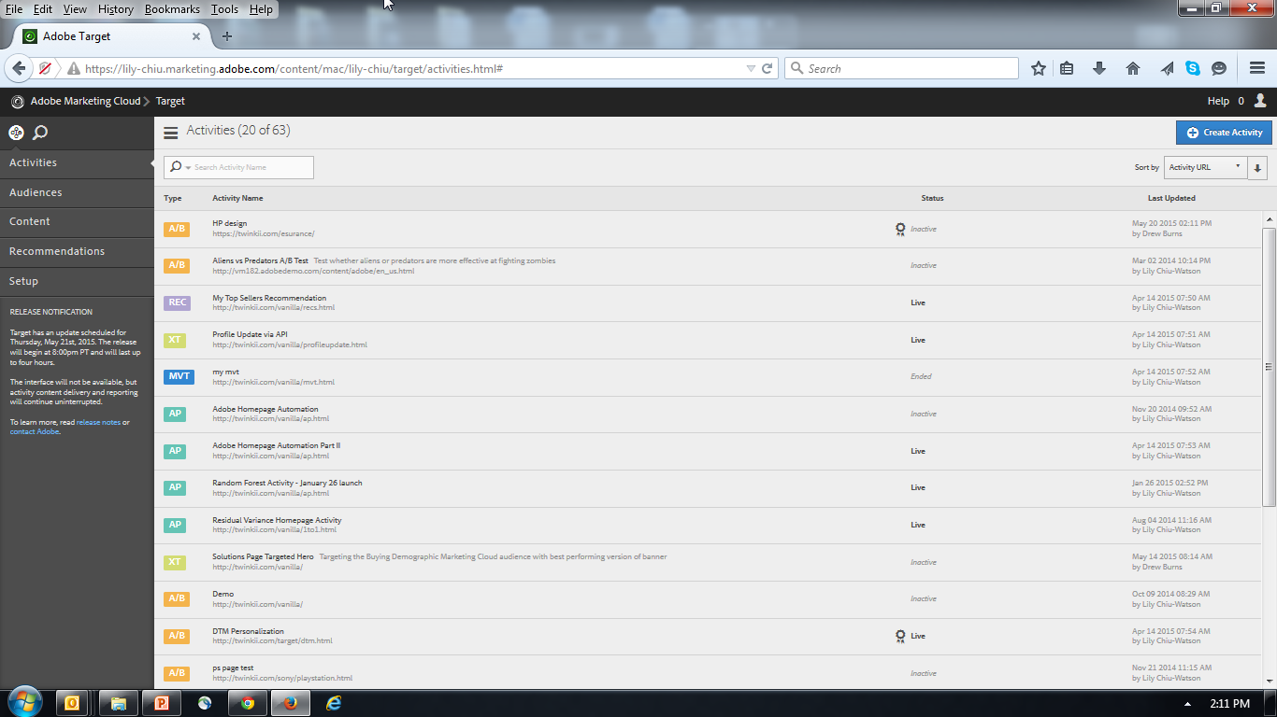
Unified Interface for all activities with built-in program governance

Slide 24
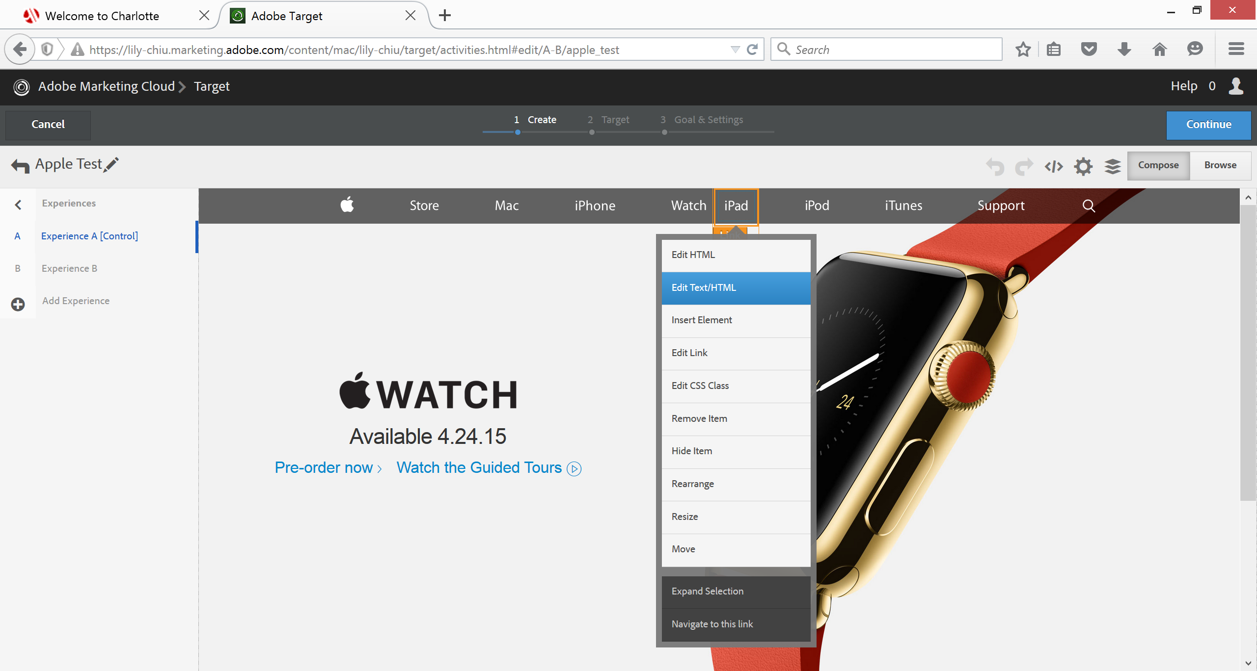
Visual Experience Composer & code access for wide breadth of activities and QA

Slide 25
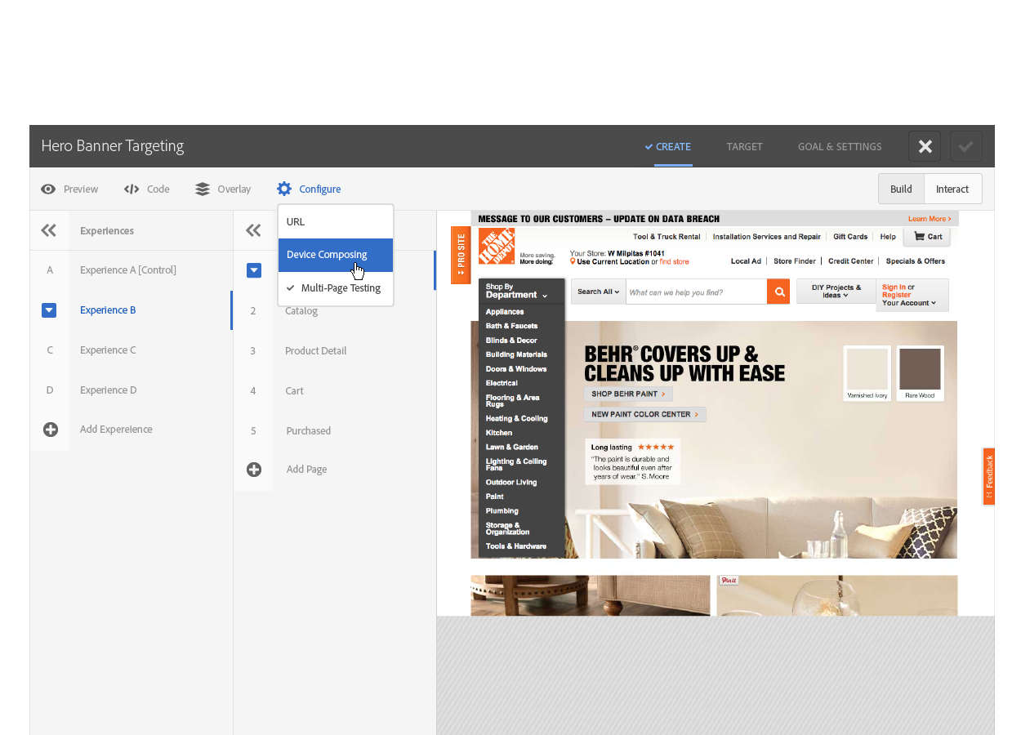
Multi-page web & mobile customer journey testing

Slide 26
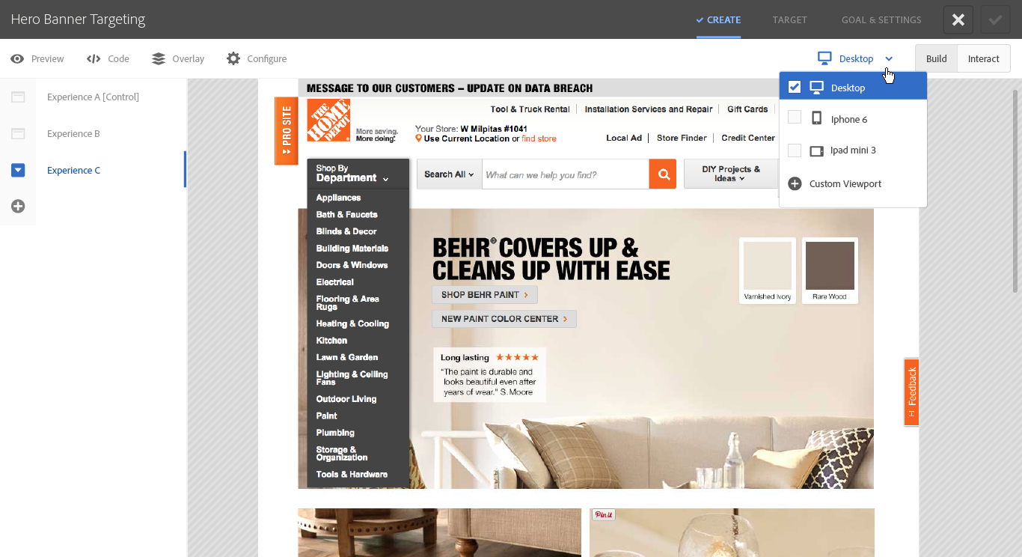
Responsive Design in Visual Experience Composer

Slide 27
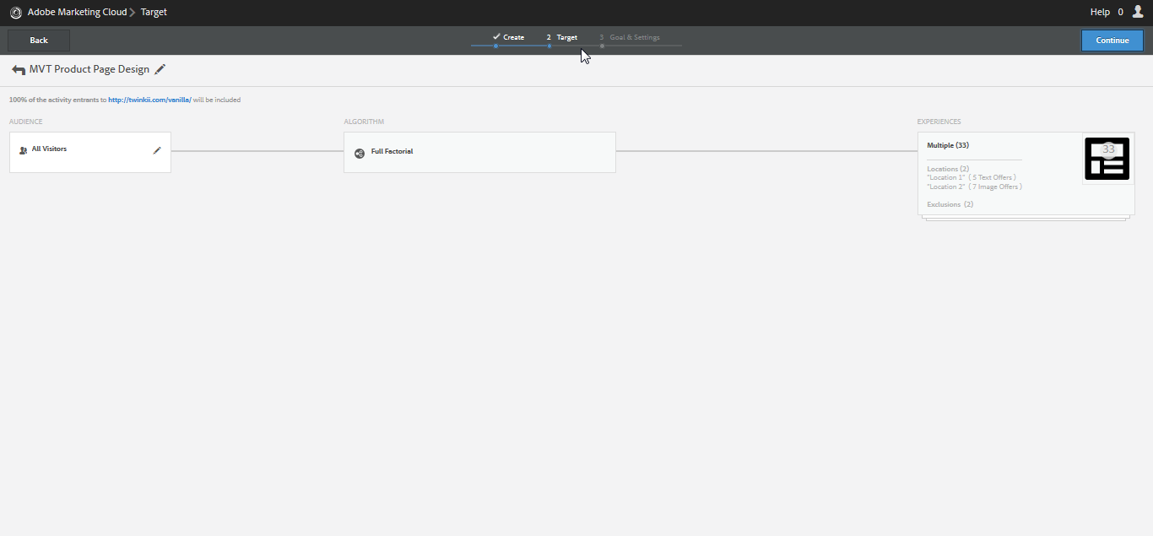
3-step, guided linear workflow standardized across all activities

Slide 28
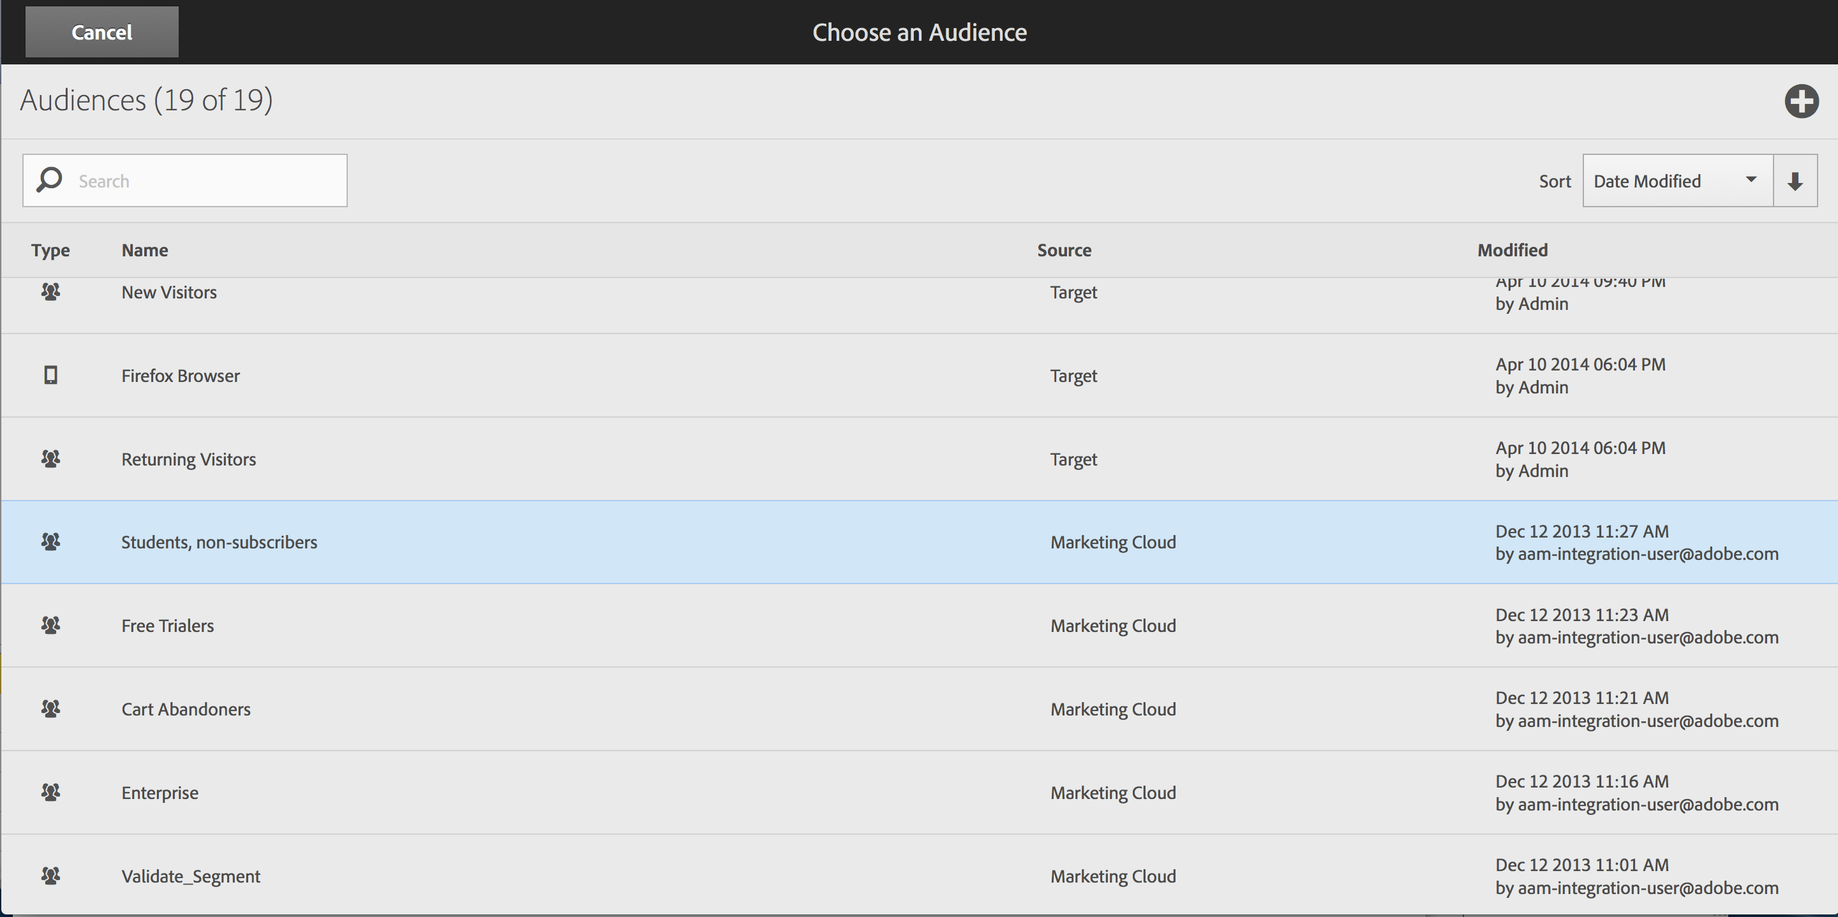
Custom Audience Library with shared Marketing Cloud audience segments

Slide 29
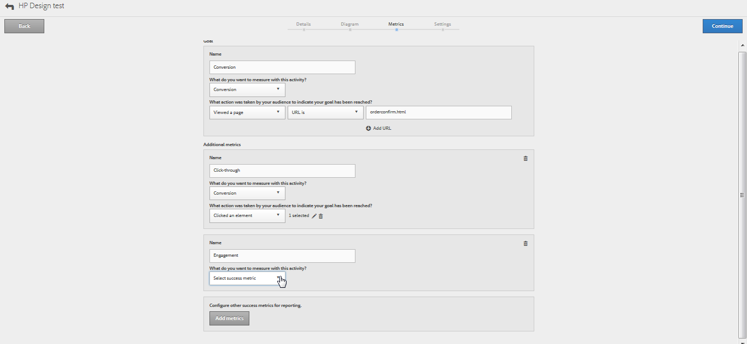
A guided process for defining conversion goals ... or leverage the full context of Analytics

Slide 30
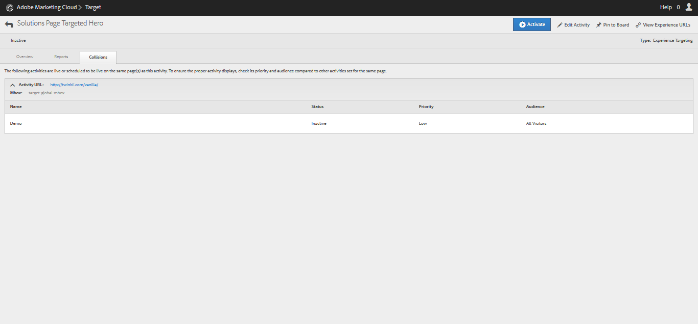
Mutual exclusivity of activity safeguards: priority & activity collision alerts for scalability

Slide 31
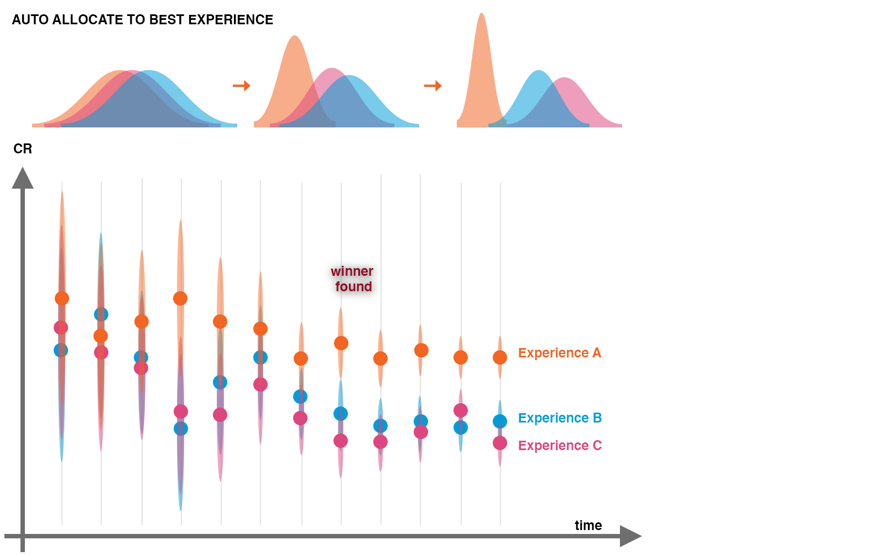
NOTES
Allocation amounts change in real-time
Visitors stick to a given experience: this preserves sanctity of an AB test
Focus on finding winner not necessarily differentiate the under-performing experiences => finds winner faster
Applies only to new visitors
By serving the high-performing experiences more often the campaign gets higher lift than a strict AB test

Slide 32
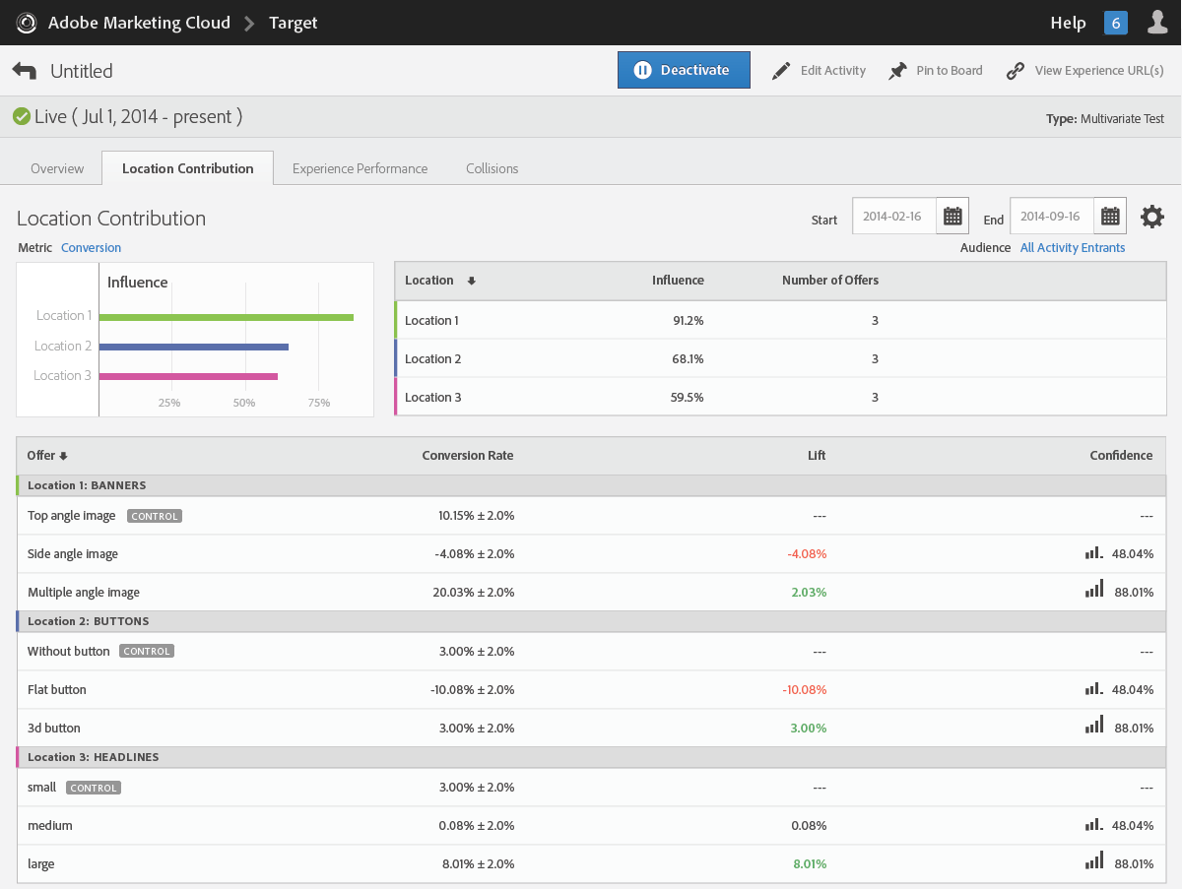
Custom Element Contribution report with visualization

Slide 33
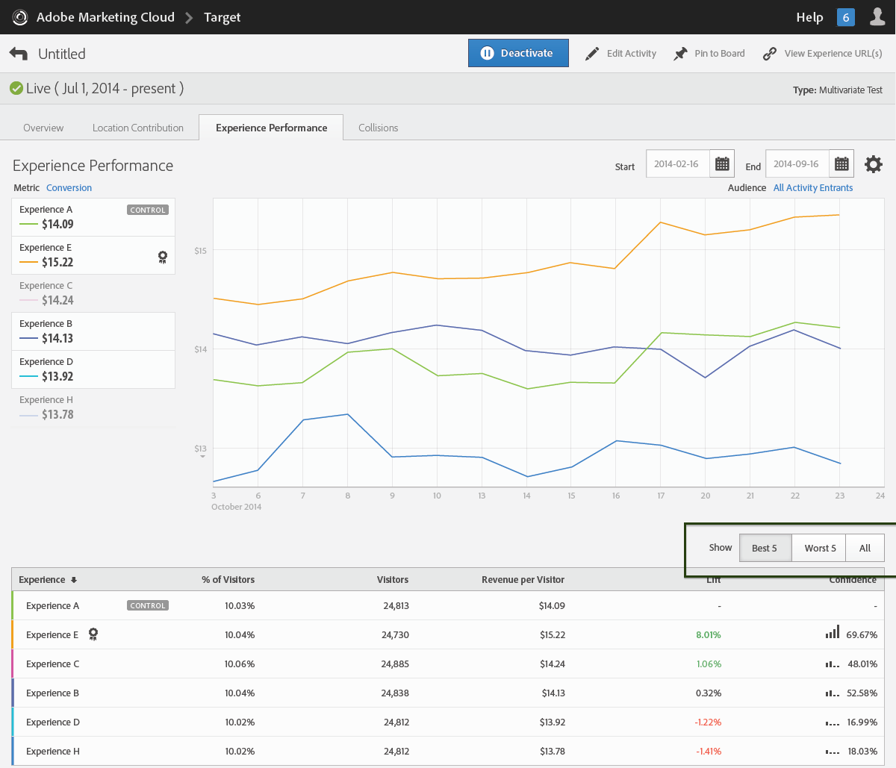
Prioritized results of the best combinations

Slide 34
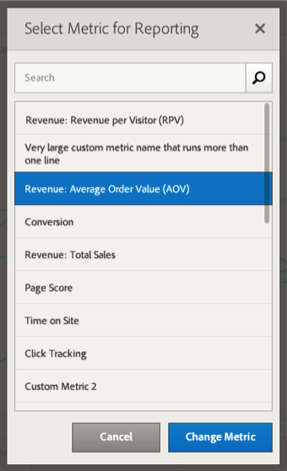
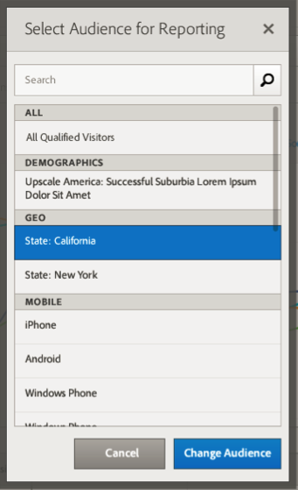
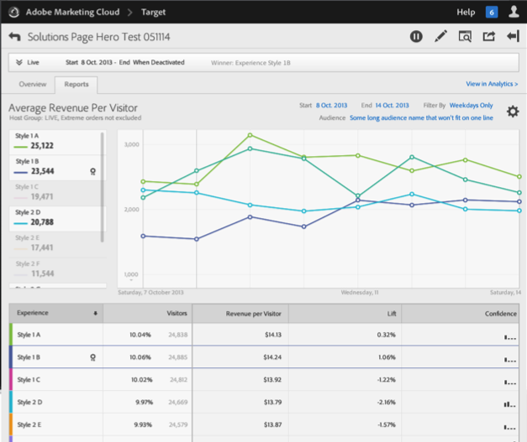
Visual Reporting with ease of filtering, or deep drill-down with Analytics
Break down any test by any audience, using any metric.

Slide 35







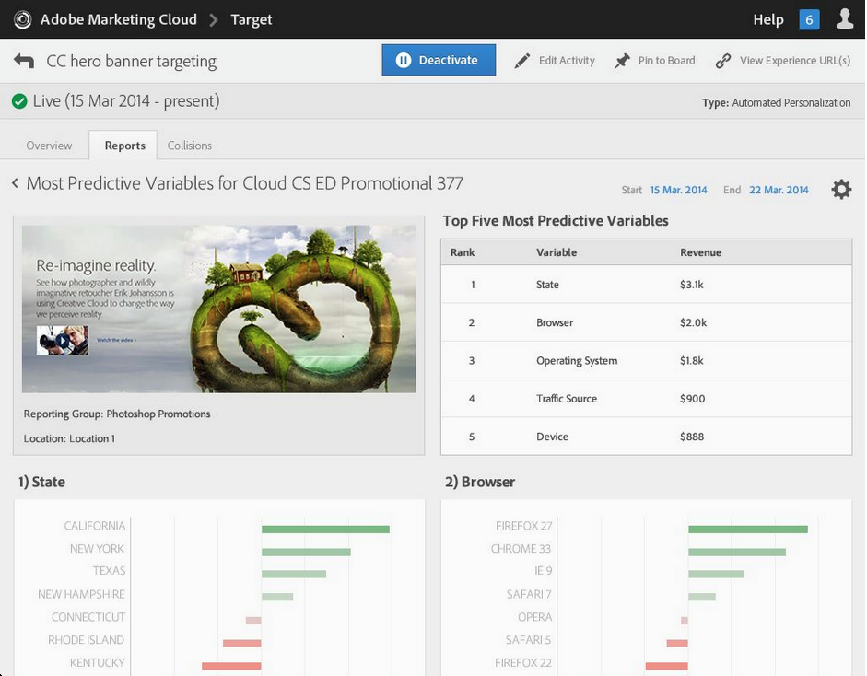
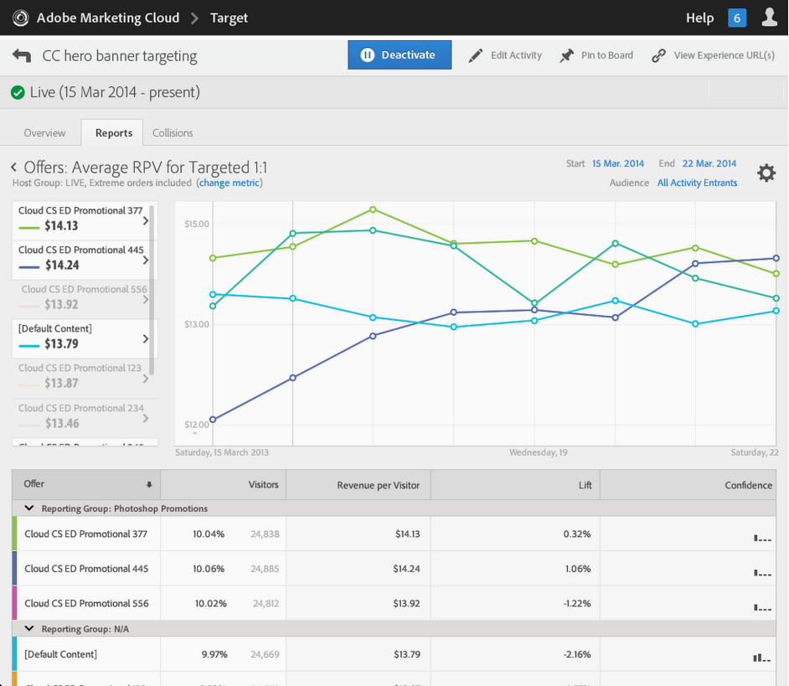
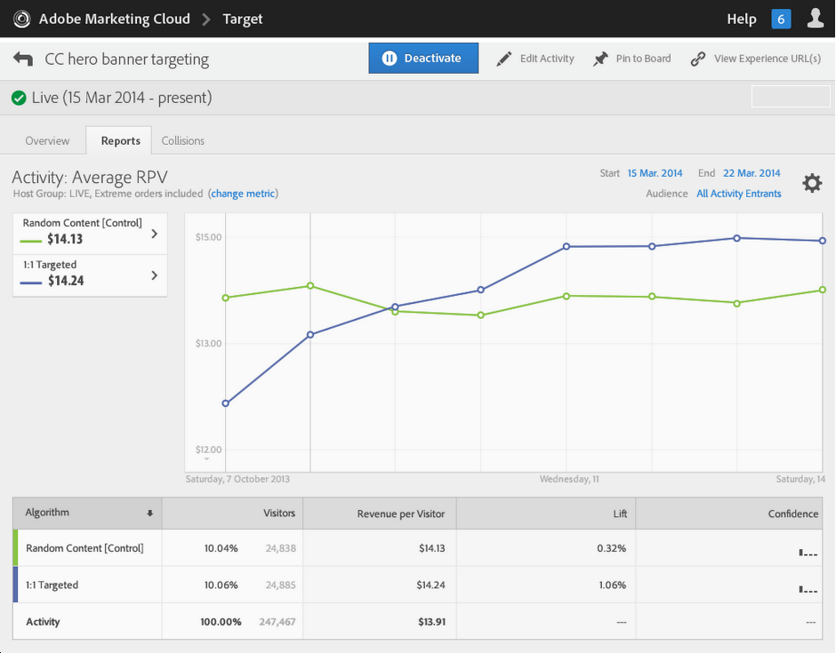



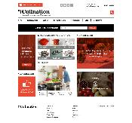
Machine-learning algorithms can assist with audience segment discovery and real-time targeting
CONTENT OPTIONS
RANDOM FOREST
1.
2.
3.
VISITS
A
B
C
D
A
A
A
B
B
B
C
C
C
1
2
3
D
D
D
Gather the user context
Figure out similar historical values
Figure out the visitor’s propensity for conversion
for each offer (or modeling group)
LAYOUT / DESIGN OPTIONS
LIFETIME VALUE
1.
2.
3.
VISITS
A
B
A
A
A
B
B
B
C
C
C
C
D
1
2
3
D
D
D
Gather the user context (and historical conversions or offers shown)
Figure out historical conversion patterns across similar visitors
Using a discounted likelihood metric, figure out the best offer to show NOW across all future likelihoods
Set of machine-learning algorithms that evaluate all profile variables to determine what is most predictive based on one (Random Forest) or several conversions (Customer Lifetime Value).
Notes:
Oftentimes, we don’t have a clue yet – a valid test hypothesis – for what is the best targeting rule to compel a visitor or customer to engage further and convert on our digital channels. This is where our machine learning algorithms within our Automated Personalization offering can be so powerful. It’s like a data analyst at your fingertips. Whether you’re looking at several different content options (or company divisions competing for a location), or you even have different design or layout options for a page (boosting product recommendations over articles, or vice versa, based on the customer), these variations can be placed in a set of decision tree algorithms, which evaluate all profile variables of the visitor and determine what is most predictive over time to deliver the next best content to compel them towards a single conversion. Or they can be placed in a customer lifetime value algorithm, that evaluates propensity for multiple conversions. Think about that level of decisioning, which could provide a better experience that leads to maximizing the depth of engagement and exponential revenue we can achieve from each individual. Several levels of reporting quickly and clearly show us how the algorithm is performing vs a random or set control, how the different experiences are performing in the algorithm, and an insights report that displays the most predictive variables for targeting each content or design/layout variation. Essentially, the equivalent of running hundreds of tests including all available profile variables to help you hone in on what you should be focused on in your personalization strategy, while automatically targeting individuals with these rules in real-time. Automated Personalization can also be applied to any A/B/n or multivariate test to help validate a test hypothesis more quickly and perhaps even return a winning variation more efficiently.

Slide 36
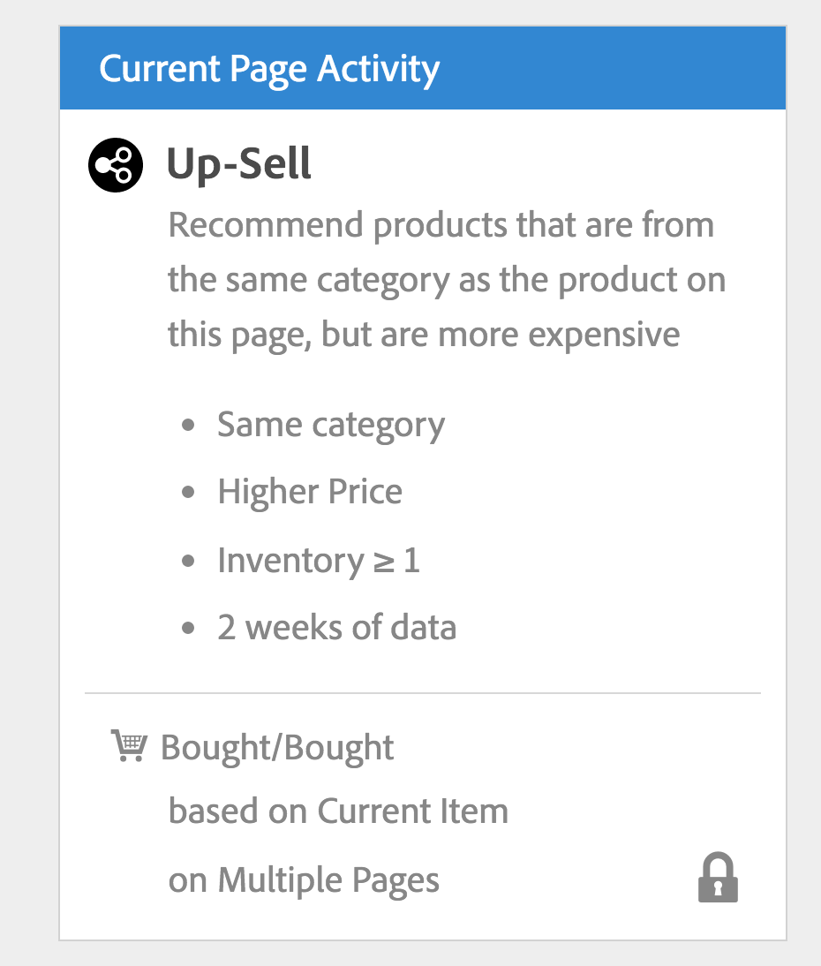
Easy to comprehend criteria for algorithms
what you can expect to see
what you can expect to see
rules & logic
rules & logic
configuration
configuration
Notes:
Introducing our new way to simplify complex algorithms
We call them: CRITERIA

Slide 37



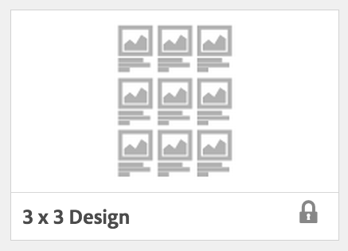

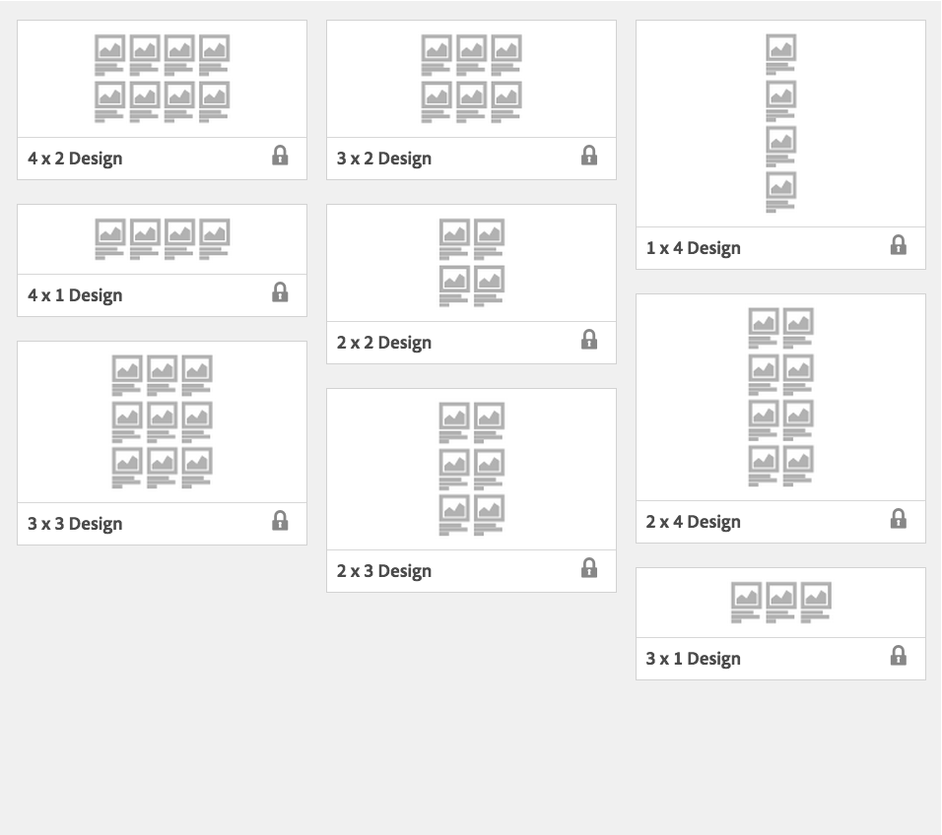
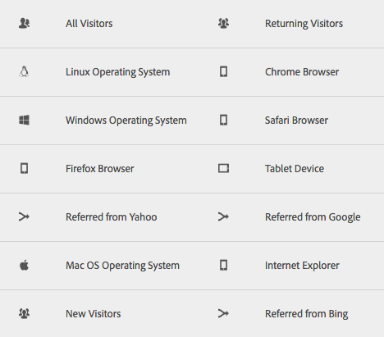
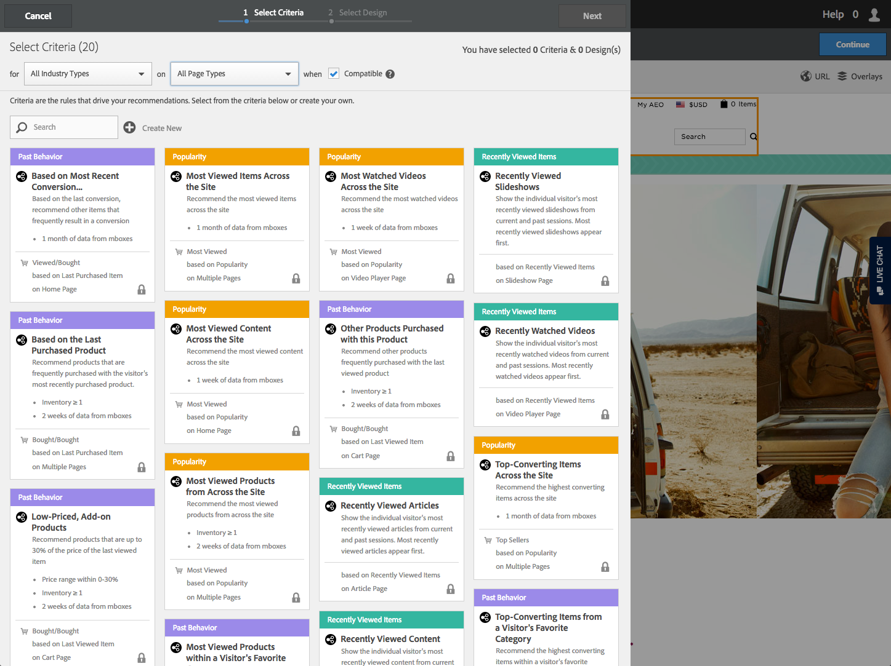
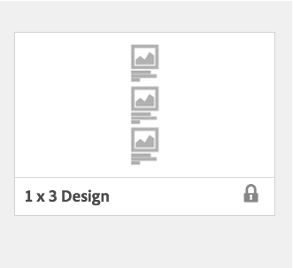
Prepackaged Audiences, Criteria (Algorithms) & Designs
13 Audiences
42 Criteria
10 Designs
New Visitors
Popularity
Most Popular Products
Recommend the most viewed products from across the site
Show Details
Notes:
----- Meeting Notes (3/2/15 13:07) -----
So I take an audience -- such as "new visitors" -- and I decide the criteria that I want to apply. {{click}}
We’re going to show these new visitors the most popular products from across the site {{click}}
Using our 3x3 design.
---------------------------------------------------
But what makes the Recommendations Premium so powerful, is that right out-of-the-box, we provide you with a lot of building blocks including:
13 audiences
42 criteria
And
10 designs
---------------------------------------------------

Slide 38
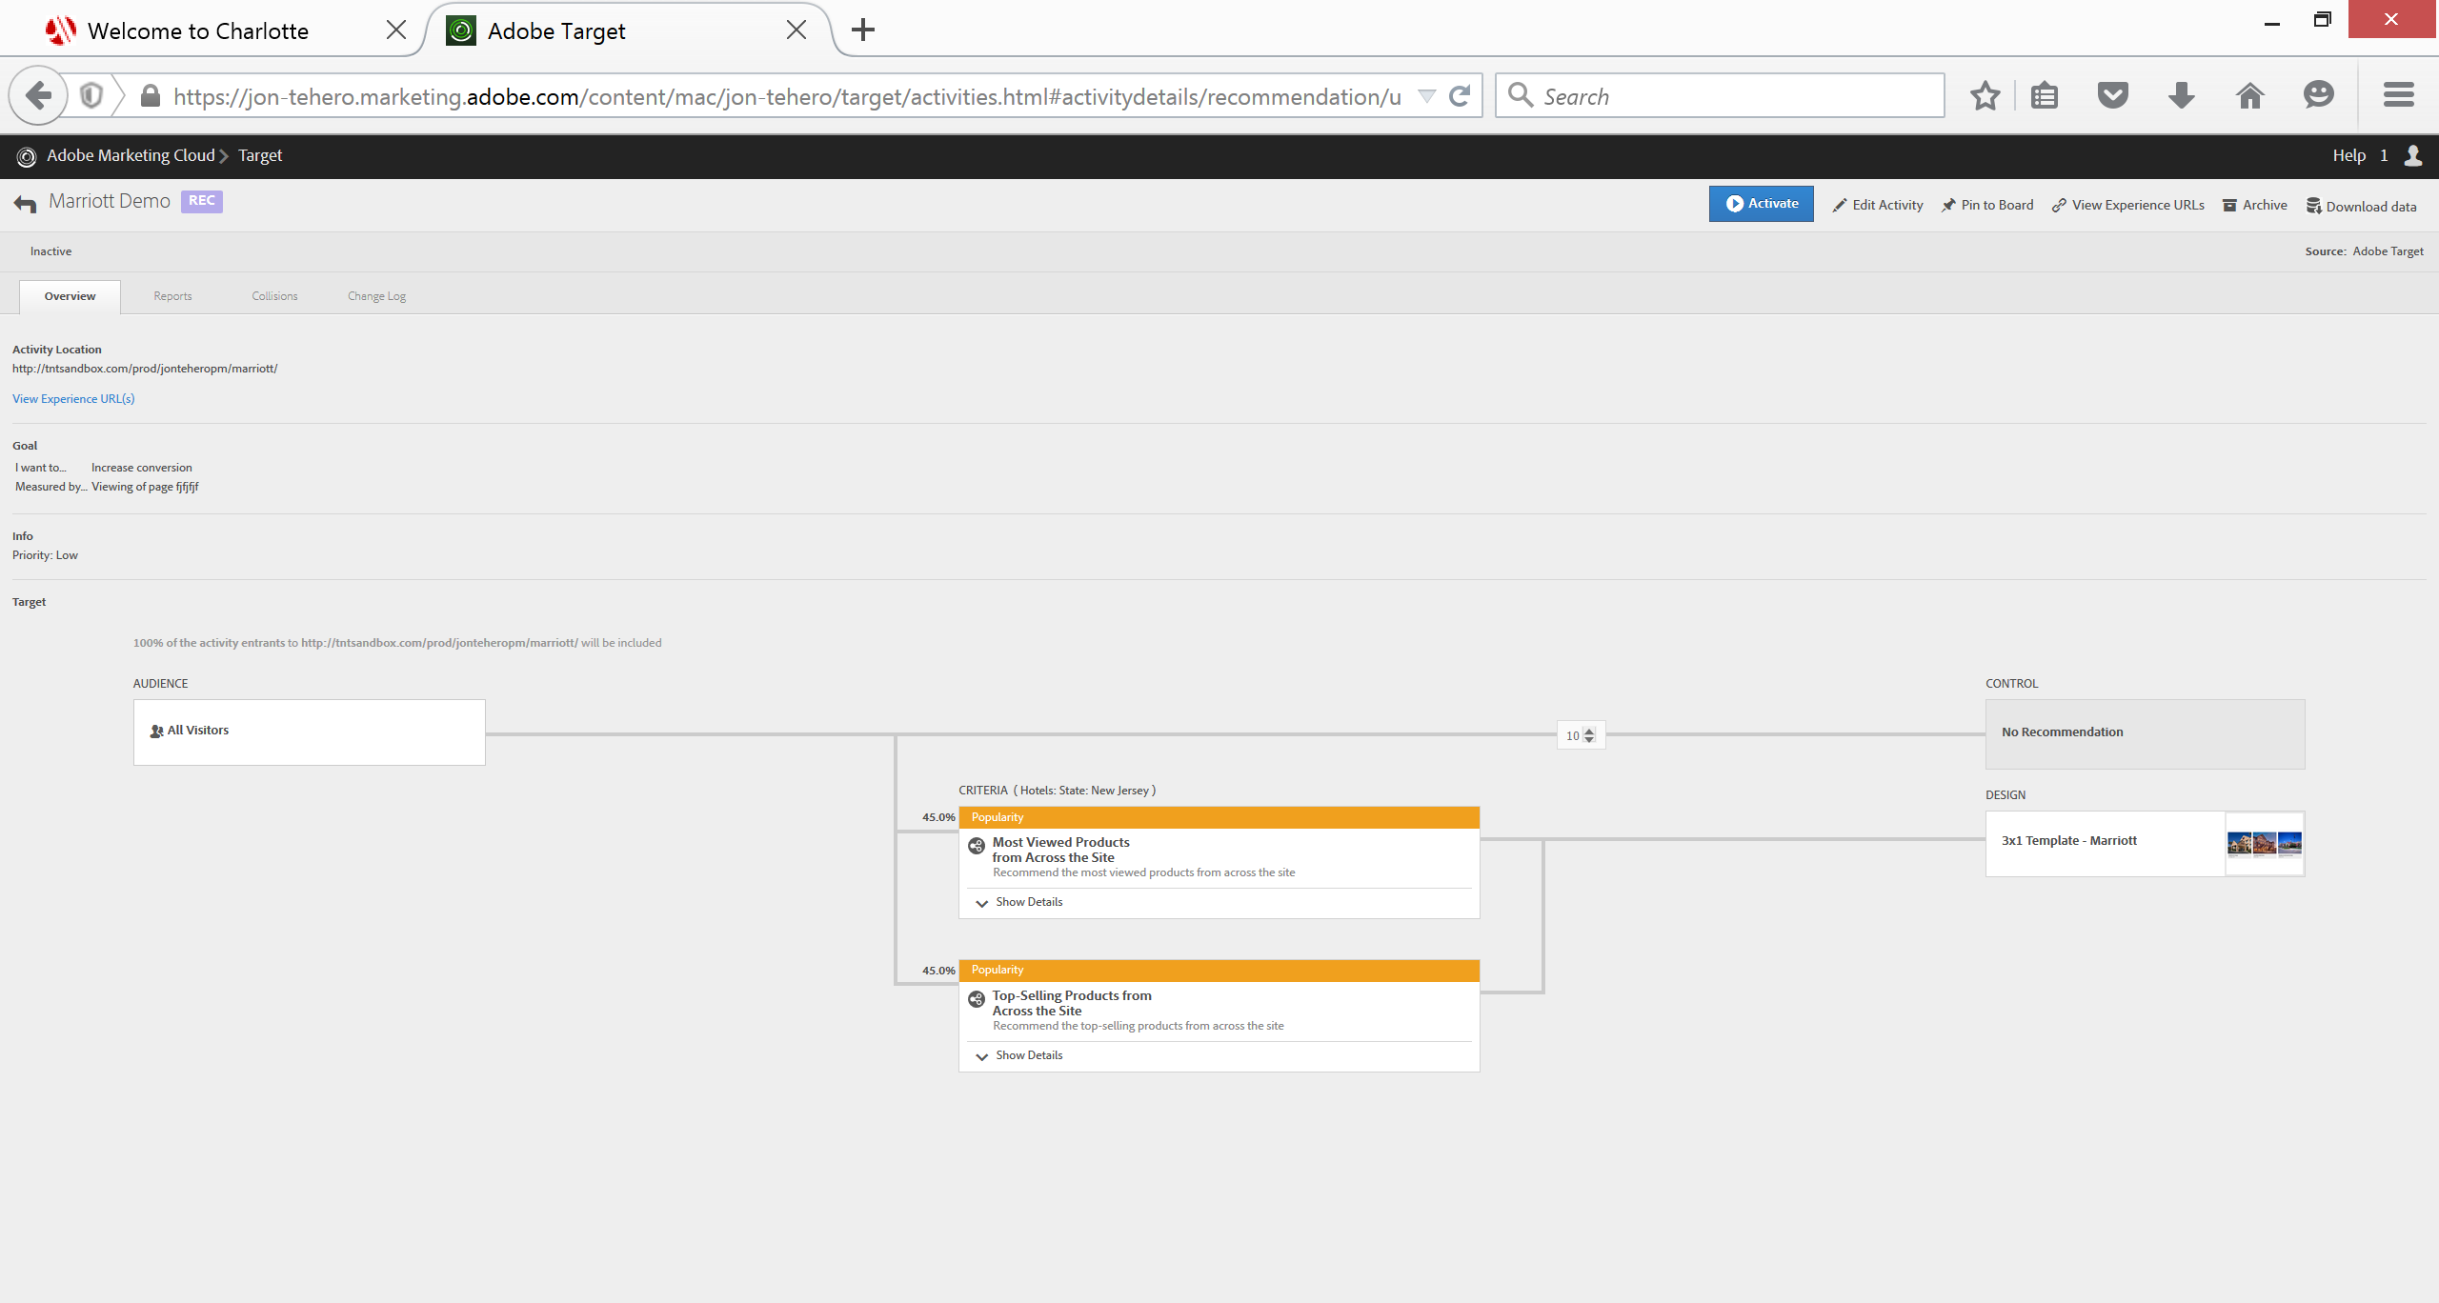
Guided workflow with built-in optimization

Slide 39

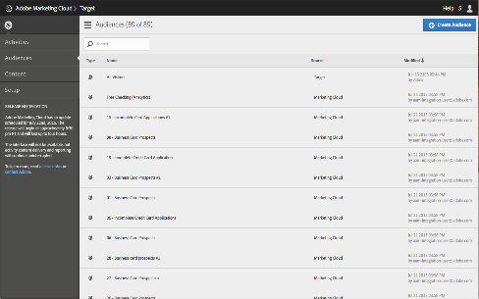









Innovation: “Target Everywhere” and Optimization of the “Internet Of Things”
ENABLED BY
40+ APIS
TARGET EMBEDDED ACROSS
Adobe Marketing Cloud & 3rd party systems
TARGET WITHIN
internet-connected devices, consoles & screens
AUTHORING/
ACTIVITY MANAGEMENT
DELIVERY
REPORTS
Profile
Create/Update Activity
Assets
Audiences
Activity Lists
Recs / AP Activity Types*
RAWBOX
Server-side delivery
Bulk Delivery*
AB/XT Activity Report
Recommendations Reports*
A4T Reports*
AP Activity Reports*
Profile update
Profile fetch
Notes:
As you have seen from the power of our combined capabilities, and their impact on performance and personalization across your digital channels, the ultimate goal is to enable what we call ‘Adobe Target Everywhere”, or the ability to have practitioners of all skills levels and all areas of the business to easily pick up and use our testing, automation and personalization capabilities when and as needed for validating decision-making and sharing insights and results. A unique differentiator is our ungated set of 40+ developer friendly APIs that allow us to perform some very unique and powerful use cases. They enable offsite testing, but they also allow us to embed our capabilities natively within any of our Adobe Marketing Cloud or even 3rd party solutions and architectures. It also allows us to extend into the “Internet of Things”, internet-connected screens and devices where we can optimize and personalize content for ATMs, digital consoles, set-top boxes, digital kiosks in stores and airports, smart homes and devices etc. Here is the buckets that our APIs fall into.

Slide 40
























Adobe Target: Key Financial Services and Insurance Customers

Slide 41


Slide 42


Adobe Target – How it Works
Standard JavaScript Tag Deployment
USERS
BROWSER
TARGET
CG SYSTEMS
Start
Visitor page request is made
Browser requests data from CG Systems
Actions measured in milliseconds
Optional profile data is returned to client
First party cookie is created/set in customer’s browser to store behavior. Page calls Target via JavaScript tag.
mbox.js
Target combines real-time captured tracking behaviors and optional enriched profile data passed from backend systems for audience & content rules.
Target returns a set of rules to change the display of content on the live client-side page
Target Activity content is displayed for the User
End

Slide 43

Why personalize?
450% increase in conversion relative to
traditional approach.

Slide 44

Notes:
[JSUN] Elliott, thank you for sharing the Sony experience.
[JSUN] This is a view into the online web store which carries over the same user based recommendations as the PS4, providing the the multi-channel user experience.
Sony is one example of new industries using recommendations and we are seeing a rapid expansion so we’ve built this into the Marketing Cloud UI.
Jon Tehero is going to demo how easy it is for any industry to get started with Recommendations.

Slide 45

Coming in Q1: Offline Evaluation of AB Campaigns Using AP Algorithms
Compare AB campaigns to AP campaigns
Passively compare an AB campaign to one where experiences were served by an AP campaign instead
TARGET EDGE SERVER
AP OFFLINE EVALUATOR
Benefit: “If you convert this AB activity to an AP activity, you can expect x% lift or $x additional revenue.
AB…N
RANDOM FOREST
RESIDUAL VARIANCE
LOGISTIC REGRESSION
NEURAL NETWORK
…
CONTENT DELIVERY BACKEND

Slide 46

Coming in mid-2016: Bring Your Own Model (PMML)
Upload Custom Models To Target
Target will allow two types of machine-learning models exposed through PMML standard and support the ability to upload custom PMML models for realtime decisioning. This enables our clients to utilize the intelligence of their data-science teams to be used for campaign targeting.
Using the offline evaluation framework, we can also evaluate the custom PPML model without actually directing live traffic to it.
AP OFFLINE EVALUATOR
PMML
RESIDUAL VARIANCE
LOGISTIC REGRESSION
NEURAL NETWORK
RF
CONTENT DELIVERY BACKEND

Slide 47

Suggested algorithms based on page and industry

Slide 48
Reasons for migrating from Adobe Target Classic (Test&Target) to Premium
Marketer & Developer UI: Native access to guided visual workflow and developer tools
Unified Interface with digital governance safeguards (support for core optimization team)
Ability to democratize & expand optimization reach within broader organization
Reimagined, redeveloped features with enhancements
Roadmap of enhancements for Premium capabilities e.g. Automation, Guided Optimization
Server-to-server Analytics integration providing shared audience segments and enhanced reporting
Streamlined implementation across channels
Flat annual fee pricing for unlimited activities (using same page view evaluation as Analytics)
APIs for Target Everywhere (server-side delivery, Target for Internet-enabled screens - IoT)
Benefits of Embedded Integrations, SSO, Core Services & much more in Adobe Marketing Cloud

Slide 49

Set Advanced Password Requirements

Slide 50

Enforce IP Address Login Restrictions

Slide 51

Customizable Access Levels via Group Management

Slide 52

Target’s Current User Roles & Permissions

Slide 53

October Release: Page/Domain Level Roles & Permissions!

